Slide 1
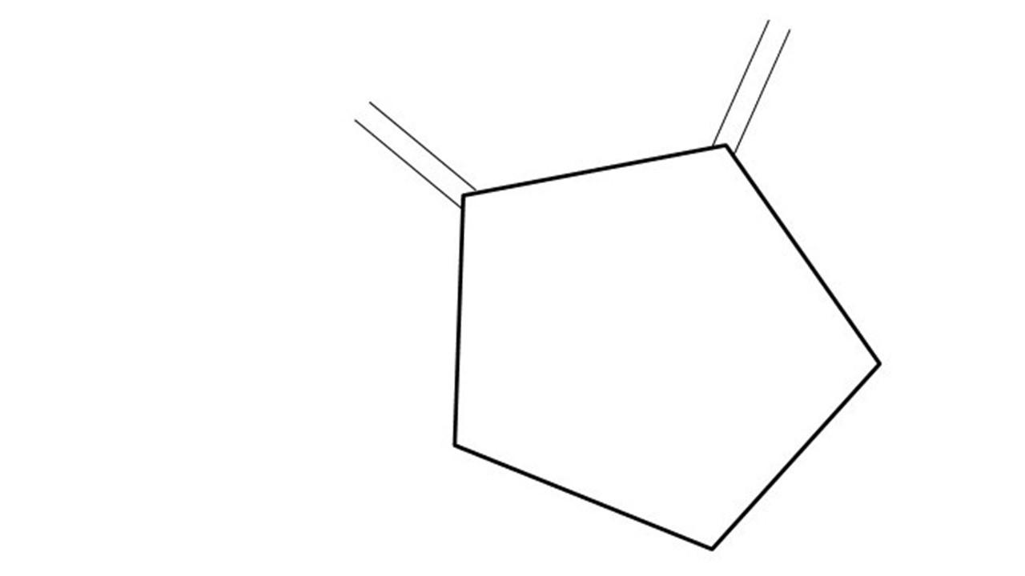
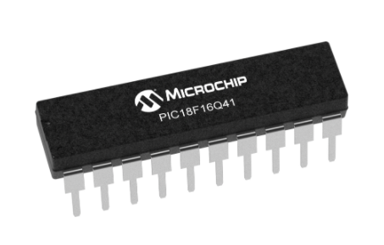
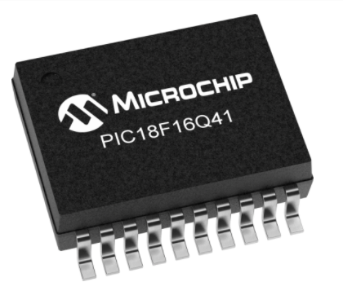
Great Cow BASIC Part 18
Great Cow BASIC for the PIC18FxxQ41 chip Family
January 2021

Slide 2
PIC18FxxQ41
PIC18-Q41 is a high performance PIC18
Digital and Analog peripherals
12-bit ADC
Multiple communication interfaces
Serial, I2C, SPI
PWM – CCP/PWM and 16Bit
Configurable Logic Cells
The PIC18xxQ41 offers 14- and 20-pin products in small footprint packages to support customers in a variety of space constrained and sensor node applications.

Slide 3
Videos...
Install the hardware and make the board work – three LED programs
Make four LEDs flash in a sequence
Set the LEDs to represent the value of ADC
Sequence the LEDs with a delay using the value of ADC
Using an input to set the state of the LED
Using the reset switch
Using the switch, ADC – the LEDs flash in a sequence with reverse
Using the serial to display values
Using the timer0 overflow, 8bit timer, 16bit timer to flash the LEDs
Using CCP/PWM to dim the LEDS
Using I²C with serial to discover I2C devices
Using EEProm – showing values on the serial terminal
Using an I²C GCLD display
Using an SPI GCLD display
Using PWM to dim the LEDS
Using memory within the PIC – Progmem and SAF memory
The Great Cow BASIC tool chain
Assembly and alternatives assemblers
Summary

Slide 4
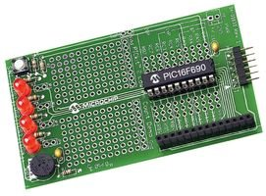
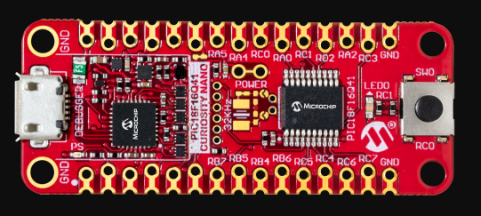

Hardware
Microchip Low Pin Count Demo Board
PICKit_2_Low_Pin_Count_User_Guide_51556a.pdf

Slide 5
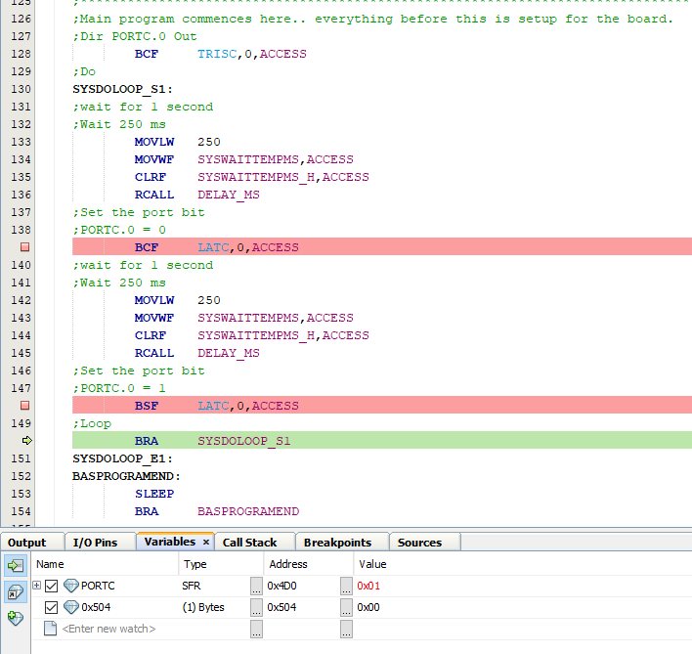
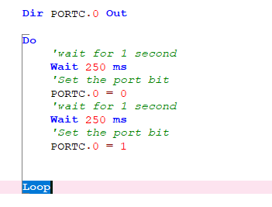
Great Cow BASIC & MPLAB-X/PIC-AS

Slide 6
Great Cow BASIC Compiler
Great Cow BASIC is an Open Source compiler for PIC, AVR and LGT microcontrollers
Great Cow BASIC now supports the 18FxxQ41 chip family
Great Cow BASIC is a cross platform with common code translation
Great Cow BASIC Compiler

Slide 7
The core compiler
High Level Language
Reports:
TXT and HTML
Source Code
Great Cow BASIC Compiler
Great Cow BASIC Compiler
Preprocessor
Code Translator
Assembler
Linker
Assembly Language
ASM file
Absolute Machine Code
HEX file
Libraries
8 bit PIC and AVR

Slide 8
Using MPLAB-X
High Level Language
Reports:
TXT and HTML
Source Code
PIC-AS,
MPLAB-IDE
Great Cow BASIC Compiler
Great Cow BASIC Compiler
Preprocessor
Code Translator
Assembler
Linker
Assembly Language
file
Absolute Machine Code
HEX file
Libraries
8 bit PIC and AVR

Slide 9
Lab
We will
Review a simple LED program
Create a Project in MPLAB-X using the Great Cow BASIC .S source
Select Standalone project
Specify chip, select the Simulator
Select PIC-AS, latest version
Name project {chipname}, specify same directory.
Finish
Now Add the Great Cow BASIC source file
Add existing item/select source .S file with AUTO
Select File/Project Properties
Set Conf:[default] Instruction Frequency to 64
Set Conf:[default] Build ing – check Execute this line after build
D:\GCB@Syn38\PICKitPlus\pickitcommandline.exe -w -p${Device} -f${ImagePath} -mpec -zv -a5
Press OK to save
Test compile <F11> and program
Use the debugger to walk the code

Slide 11
Videos...
Install the hardware and make the board work – three LED programs
Make four LEDs flash in a sequence
Set the LEDs to represent the value of ADC
Sequence the LEDs with a delay using the value of ADC
Using an input to set the state of the LEDs
Using the reset switch
Using the switch, ADC – the LEDs flash in a sequence with reverse
Using the serial to display values
Using the timer0 overflow, 8bit timer, 16bit timer to flash the LEDs
Using CCP/PWM to dim the LEDS
Using I2C with serial to discover I2C devices
Using EEProm – showing values on the serial terminal
Using an I2C GCLD display
Using an SPI GCLD display
Using PWM to dim the LEDS
Using memory within the PIC – Progmem and SAF memory
The Great Cow BASIC tool chain
Assembly and alternatives assemblers
Summary

Slide 12
Great Cow BASIC
Great Cow BASIC for the PIC18FxxQ41 chip Family
January 2021

Slide 14
Backup Slides

Slide 15
Great Cow BASIC & MPLAB-X/PIC-AS

